Slide 1

Workflow vs Dynamic Agents.
Customer Support Ticket Handling

Slide 2
Use Case
Customer Support Ticket Handling in a SaaS Product
Involves diagnosis, routing, and resolution
Common across IT, product, and operations teams

Slide 3
Design #1 — Predictable Workflow (Fixed Steps)
Receive Ticket
Classify Issue (Billing, Technical, General)
Route to Correct Team
Team Resolves Issue
Close Ticket & Notify Customer

Slide 4
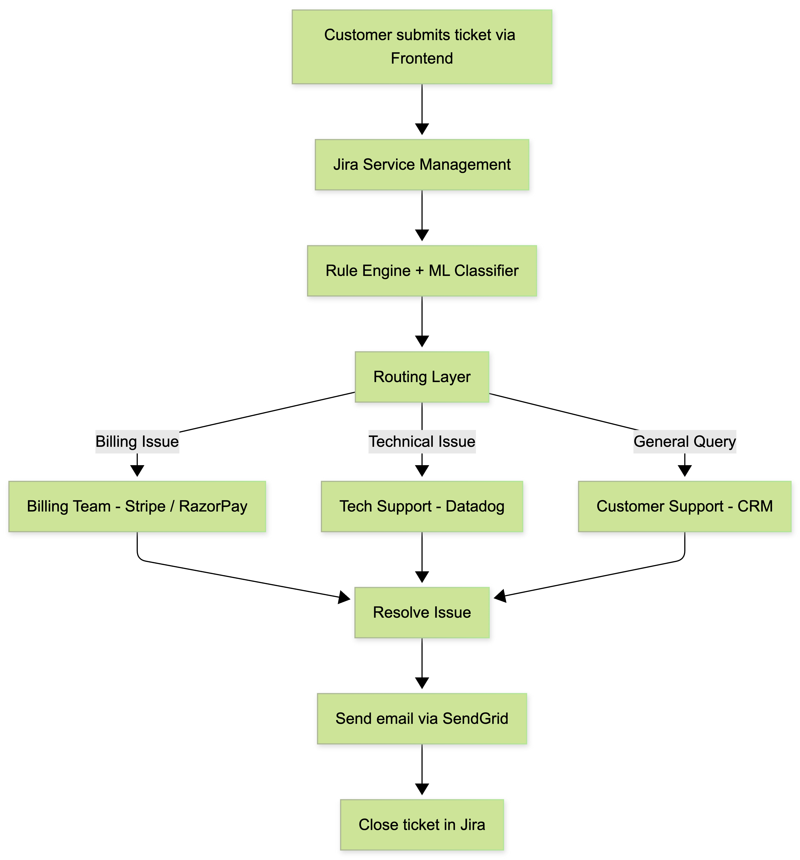
Flow Chart

Slide 5
Workflow Architecture View
User → Helpdesk System → Rule Engine → Team Queue → Resolution
Deterministic path with no AI reasoning
Every ticket follows the same structure
Easy to audit and monitor

Slide 6
When Workflow is Ideal
High volume, repetitive issues
Low ambiguity
Strict compliance needed
Need predictable SLAs
Examples: password reset, refunds, access requests

Slide 7
Design #2 — Dynamic LLM Agent
LLM reads the ticket and reasons about intent
Decides tools dynamically based on context:
- Fetch customer record (CRM API)
- Check invoices (Billing API)
- Search knowledge base (Vector DB)
- Read app logs (Logging system)
- Draft response or escalate to human

Slide 8
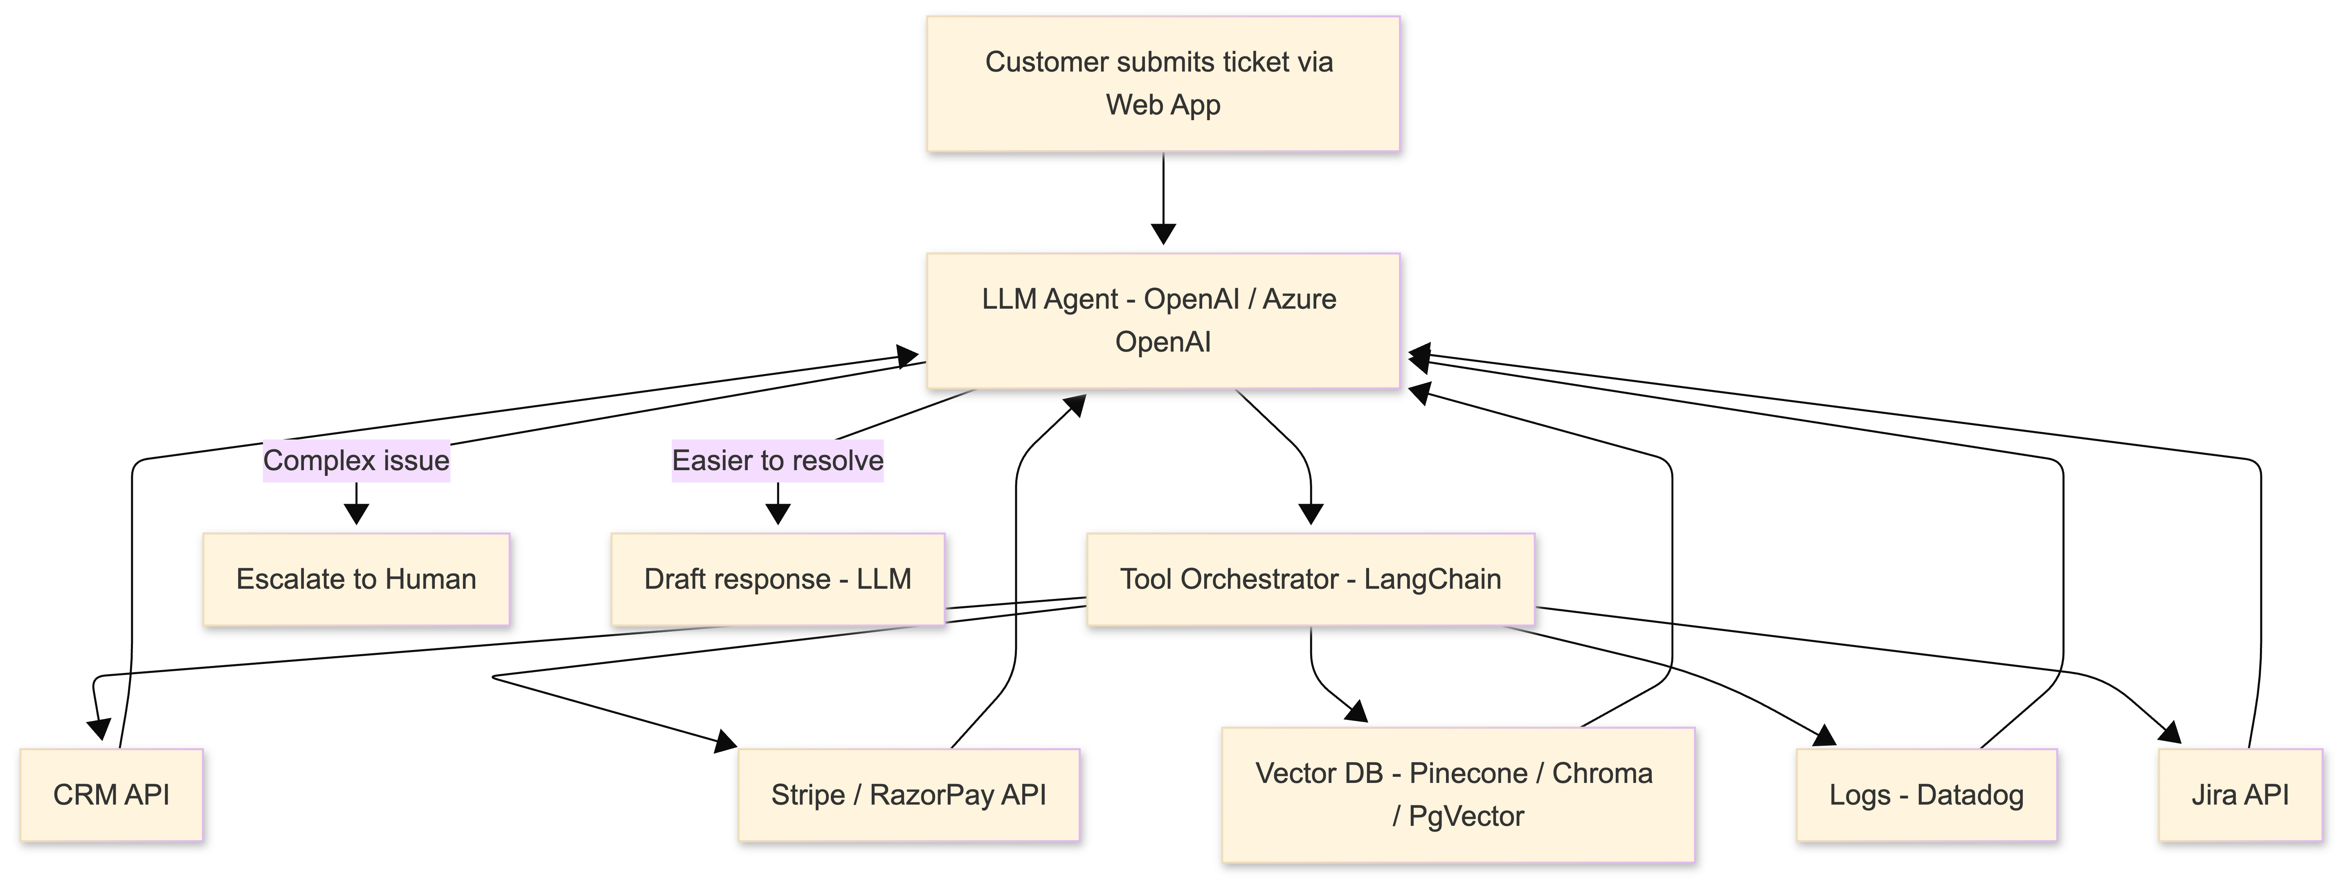
Flow Chart

Slide 9
Agent Architecture View
User → LLM Agent → Tool Orchestrator → Multiple Systems
Path is NOT fixed; depends on situation
Agent can combine data from many sources
Learns from past cases over time

Slide 10
When Agent is Ideal
Complex tickets with mixed issues
Unclear or novel problems
Need reasoning across systems
Examples: billing + app crash + data loss together

Slide 11
Direct Comparison
Predictable Workflow
  Fast and reliable
  Rule-based
  No reasoning
  Easier governance
  Best for routine tasks
LLM Agent
  Flexible and intelligent
  Tool-driven
  Context-aware reasoning
  Harder to govern
  Best for edge cases

Slide 12

Thank You
Kanishkaran M
kanishkaranm@presidio.com

